Slide 1
Was 536 AD the worst year to be alive?

Slide 2
‘The sun was dimmed, its light seemed to be like the light of the moon’
– Procopius

Slide 3
Historians have long been puzzled about why records and chronicles around the world mention famines and crop failures around the year 536.

Slide 4
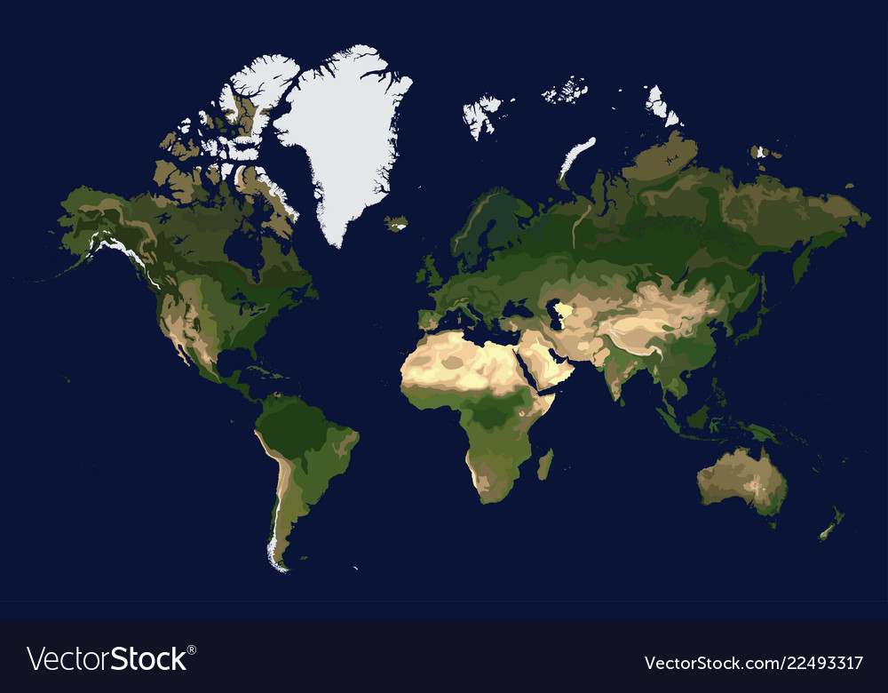
‘Failure of bread’– Annals of Ulster
Snow in August– Ching government records
Cities abandoned – Maya lowlands

Slide 5
Now historians are analyzing a new form of evidence that has emerged that perhaps offers an explanation:
ice cores

Slide 6
Each year, ice sheets get a new layer.
The frozen layers preserve particles in the air from a given year.

Slide 7
By taking a cross-section of layers, scientists and historians can analyze those atmospheric particles.

Slide 8
In the layer from 536, scientists found particles consistent with…

Slide 9
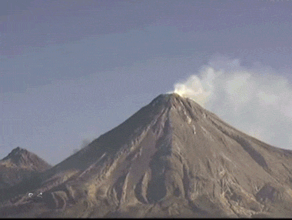
… a volcanic explosion

Slide 10
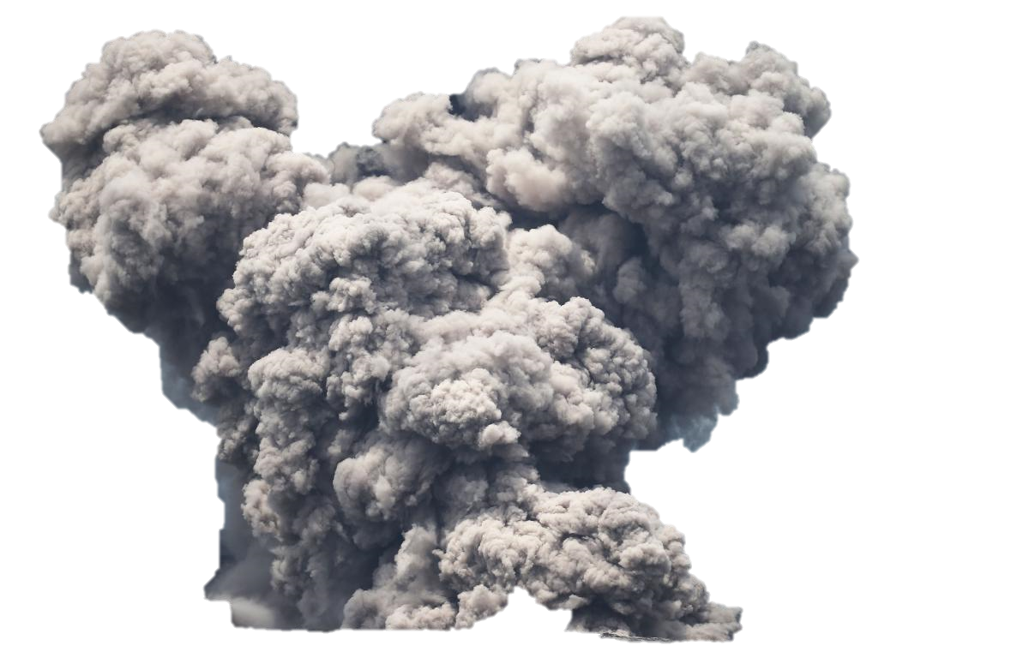
The volcanic eruption of 536 could have blocked out sunlight over a huge area…
…leading to crop failures and famines and plague.

Slide 11
And you thought 2020 was bad…

