Slide 1
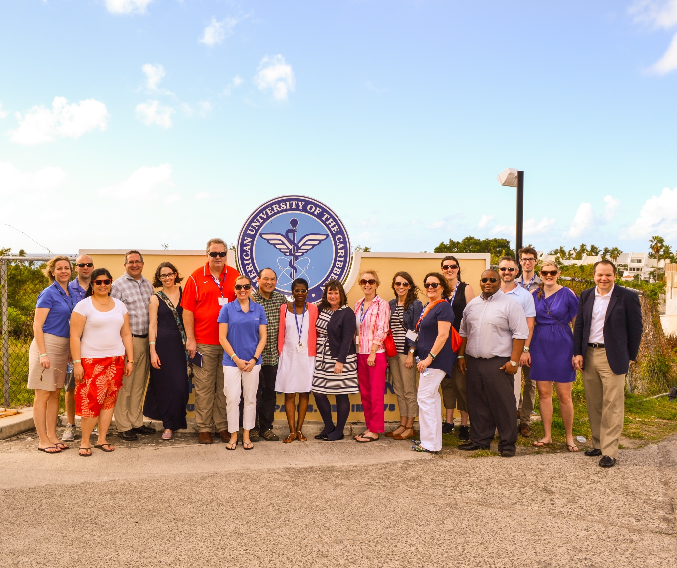
Pre-Med Advisor Visit to AUC
2/25/15 through 3/1/15

Slide 2
History/Legacy of AUC
Dr. Paul Tien started AUC in 1978, when his son dreamed of going to medical school.
Born in China, Tien grew up in Taiwan, emigrated to US and became an electrical engineer. AUC was first situated on the island of Montserrat.
Hurricane Hugo hit there in 1989, and students and faculty had to relocate. After a volcano (thought not to be active) erupted in 1995, AUC was re-established on the island of St. Maarten. Half went to Belize, half to TX.
The resiliency of the faculty and staff during that time is still evident in today’s AUC family. They built to withstand a Cat 5 hurricane.
His son never graduated from medical school, but interesting fact I learned is that he and his wife (an MD) now own Rocky Vista COM in Colorado, a for-profit institution).
DeVry Education Group bought AUC in 2011, and invested much $$ in new buildings and facilities.

Slide 3
AUC’s Mission
AUC’s mission:
•To promote servant leadership, as technology doesn’t replace human touch
•Focus on the physician’s relationship with his patient •Understand that most students matriculating at AUC are stigmatized when telling their family and friends. Most outsiders make summary judgments without real knowledge.
C- Common Good
O- Opportunity
R- Responsiveness
E- Excellence
These traits will help raise AUC’s value and build their reputation.

Slide 4
What are they looking for??
Interviews
LOR’s – no more than 5; 1 science, 1 other faculty plus optional (prefer one from community)
GPA – both cumulative and science
MCAT – past 5 years
Personal Statement
Chronological listing of education (CV), employment history, detailing any time taken off
BS degree, transcripts & prereq courses
Average MCAT is 25 (at least an 8 on BIO)
Average OGPA = 3.3
Average SciGPA = 3.1
Notes:
conducted at different locations, face-to-face
(B,C,P…no Math)
(where & what major goes into account), No grade forgiveness honored

Slide 5
After interview, then what?
Applicants receive a decision within 2-5 weeks:
1. Accept
2. MERP (Medical Education Readiness Program)
3. Denial
MERP – remediation semester. Those students perform better than those accepted straight out. If they don’t pass, money is completely refunded ($10,000)
Once accepted, students are assigned an Orientation Advisor to answer any and all questions, even before matriculation
Notes:
MERP= 1 semester, if you pass, then you are guaranteed an acceptance
*45 students cap in MERP

Slide 6
Student Stats
•15% over the age of 30
•In 2013: Female = 41%,
Male = 59% (Not purposely)
•Most drawn from state is CA
•85% American citizenship
•There is a 30% acceptance rate vs. number of
applications

Slide 7
Enrollments
January semester = 100-150
May semester = 100-150
September semester = 200-250
(recommend applying 5 months before desired start)
Class sizes currently comparable to those in US medical schools

Slide 8
Tuition & Funding
Medical Sciences = $19,550 per semester (1-5)
Clinical Sciences = $21,875 per
semester (6-9)
$10,938 for ½ semester
Access to Title 4 funding; complete FAFSA
Notes:
Dr. Sadler’s total was $307K, Dr. Azinge was $250K (low end); she suggested that budgeting help needs to be given to current students

Slide 9
Student Involvement & Support
Focus is on service learning and community affairs, partnering and instilling a sense of responsiveness for quality of life on island
.
• 17 student organizations, including professional, religious, honor and service, AND SGA
• Community events:
Project Help (free health screening)
Diabetes screening
St. Maarten Zoo
Working with the elderly, AND health and exercise with
kids
• The Wellness counselor offers a “mindfulness based stress reduction” program (meditation-based).
• Peer-to-peer tutoring (one-on-one assistance in areas needing improvements)

Slide 10
Student Support (cont’d)
2 scholarships awarded:
• Social Accountability Award (social awareness)
• Student Engagement (demonstrated highest level of service to the school)
Once a month, the Source of Pride Award is given. AUC is the perfect setting for concentrated study with close proximity to resort recreational activities.

Slide 11
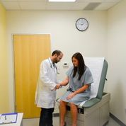
The Journey
• 5 semesters – medical
sciences
• USMLE 1
• Semesters 6-9.5 = Clinical
Sciences
• USMLE 2
• Graduation
• Residence placement
• USMLE 3 (can sometimes be
done before residence
placement)
• Physician Licensure

Slide 12
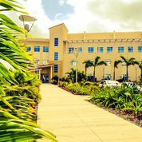
New Campus Building

Slide 13
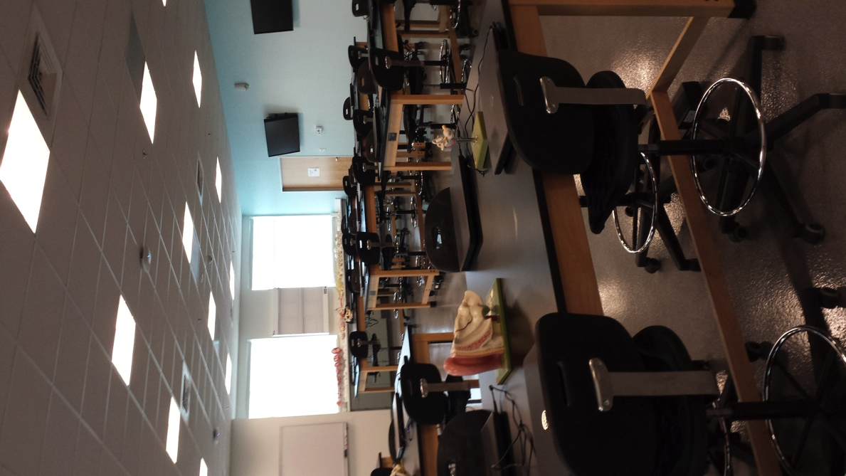
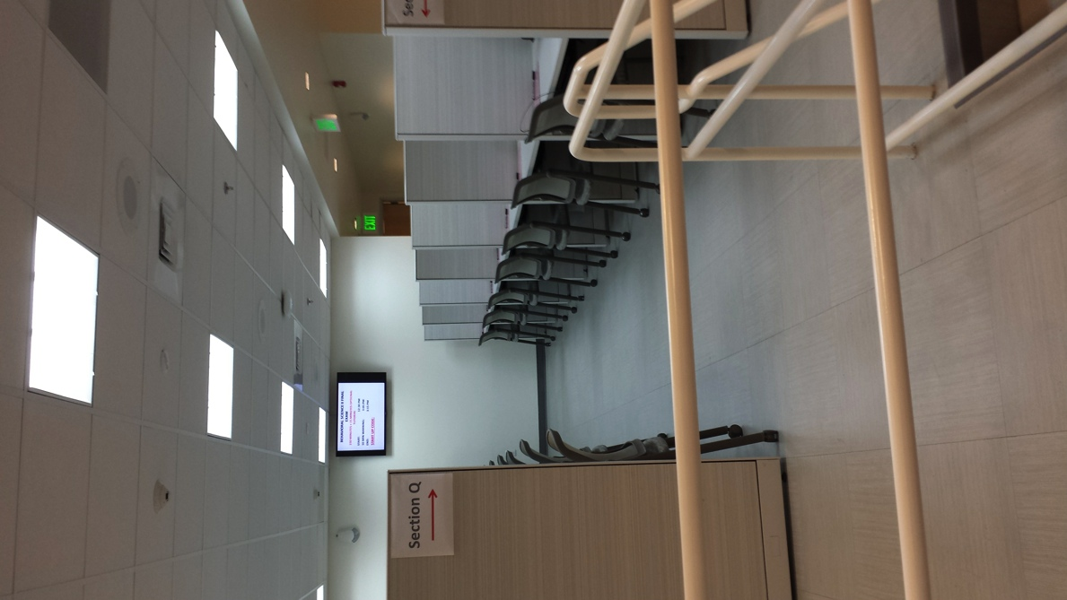
New Facilities
New Anatomy Dry Lab
New Testing Center
Notes:
Anatomy Wet Lab is only 14 months old, with “revolving” cadaver tables (2-tiered), which allows more cadavers in the lab.

Slide 14
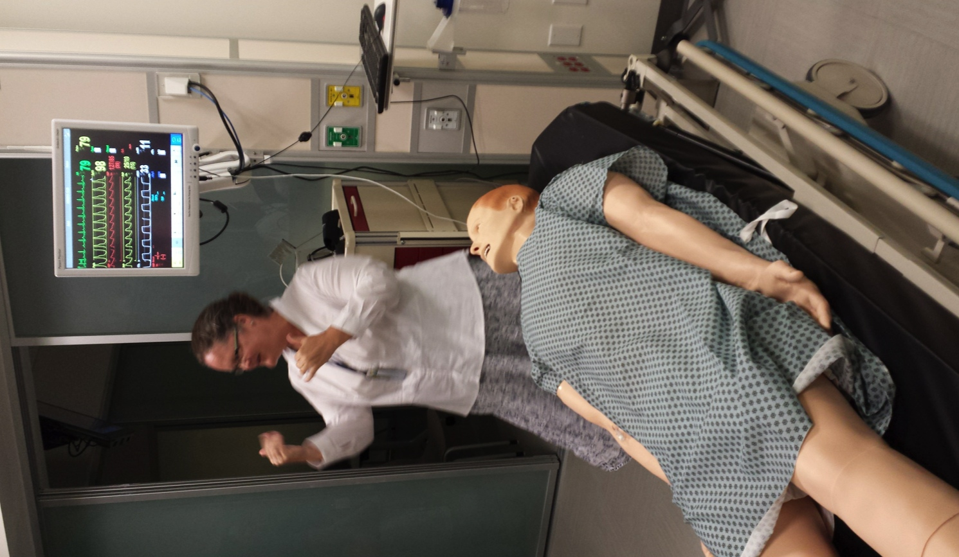
Simulation and Clinical Skills Lab
“Introduction to Clinical Medicine” (ICM) bridges the gap between classroom instruction and clinical skills.

Slide 15
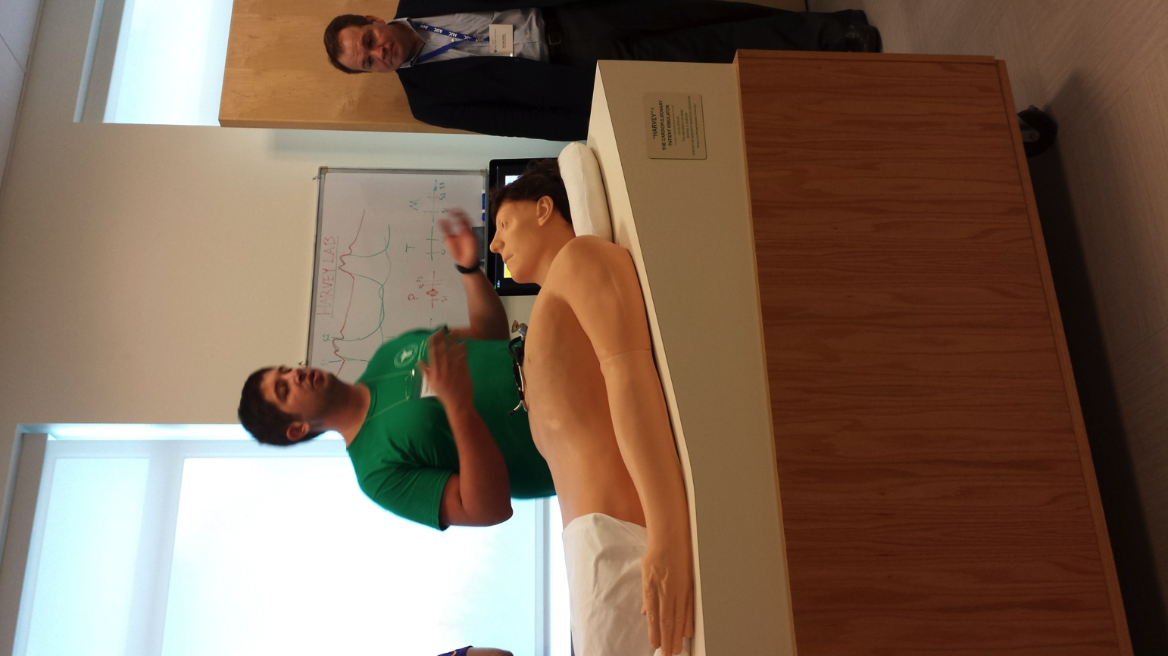
Fred, a student teaching assistant in the Sim Lab, demonstrated his skills on “Harvey” the patient simulator. We were allowed to wear stethoscopes and hear the heartbeat.
SIM Lab (cont’d)

Slide 16
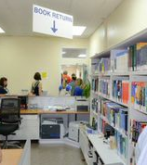
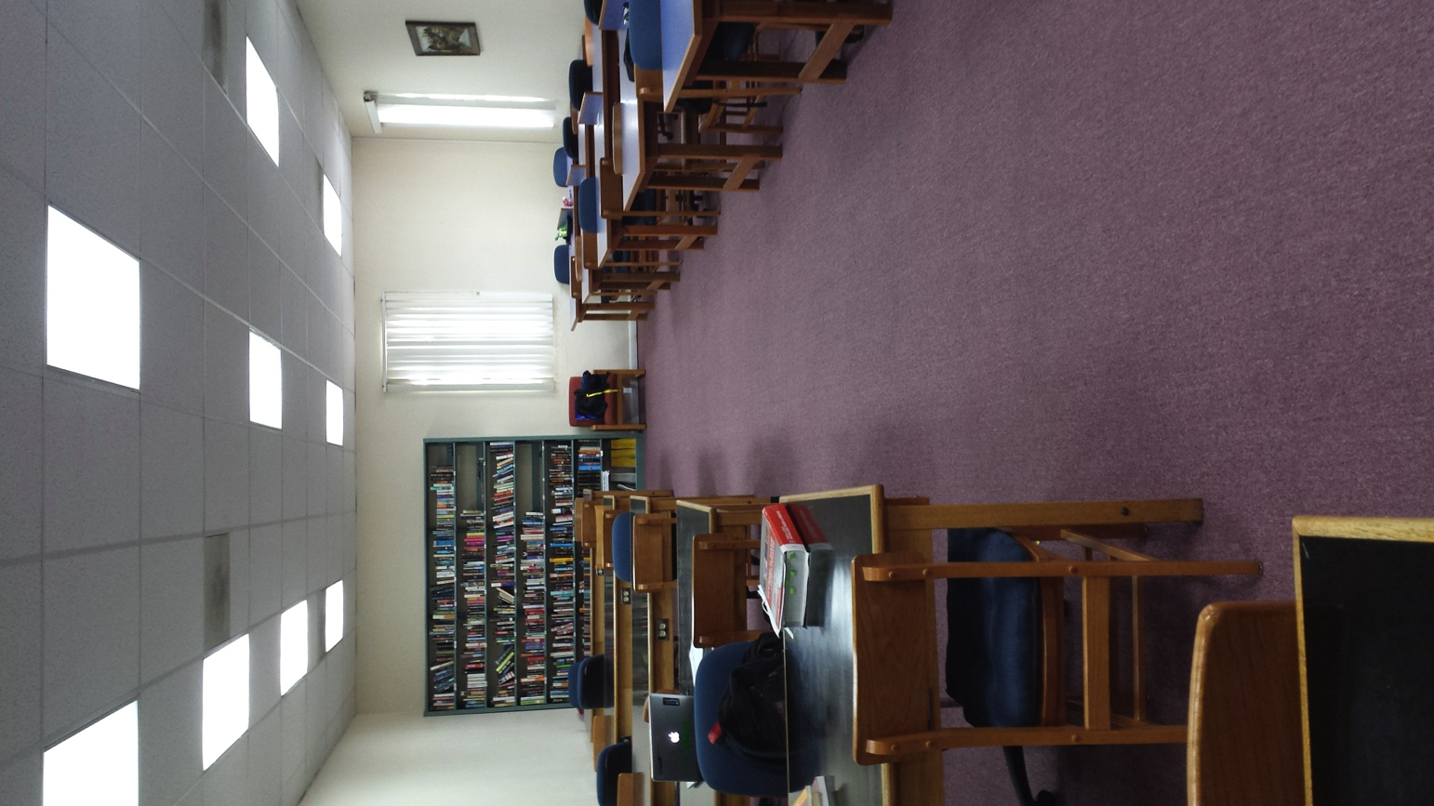
The Library

Slide 17
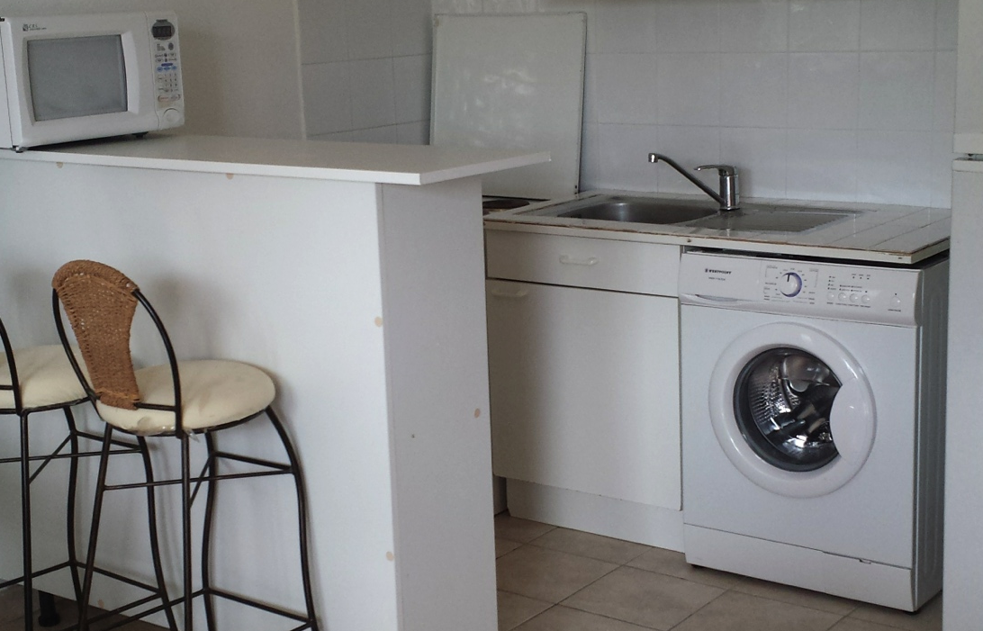
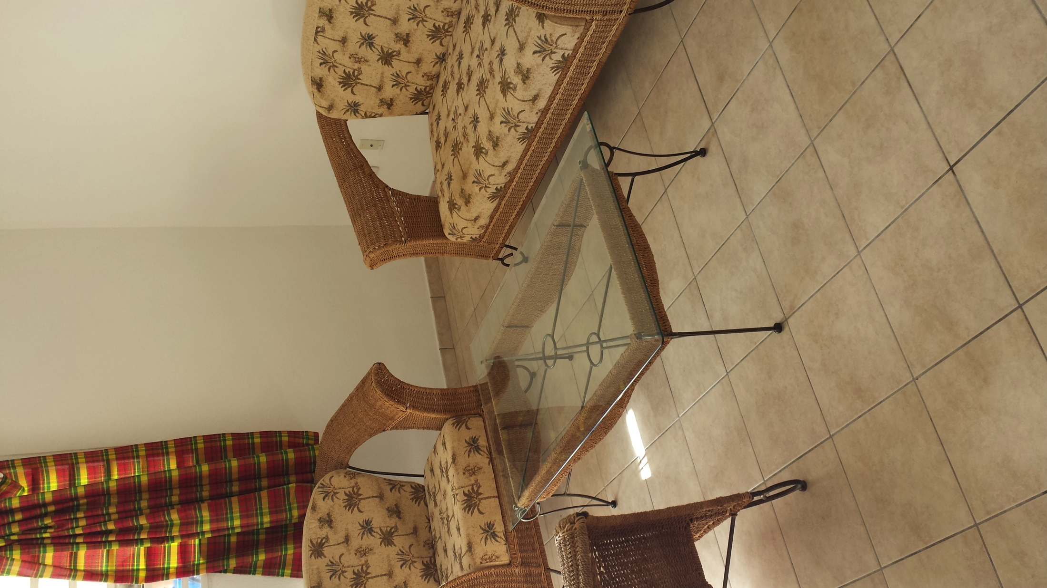
Apartment Housing
Off-campus housing…$1100-1200 per month.
On-campus housing is $1350/month for a single bdrm.,
2 bdrm. is $1150 a month/per student.
BUT…
Notes:
The campus generates its own electricity, important during hurricane season
Students live in the dorms 1st semester (not called dorms now, rather campus apartments)
Since DeVry, there is enforced security. Previously, there was a spike in crime, but now it’s much improved.

Slide 18
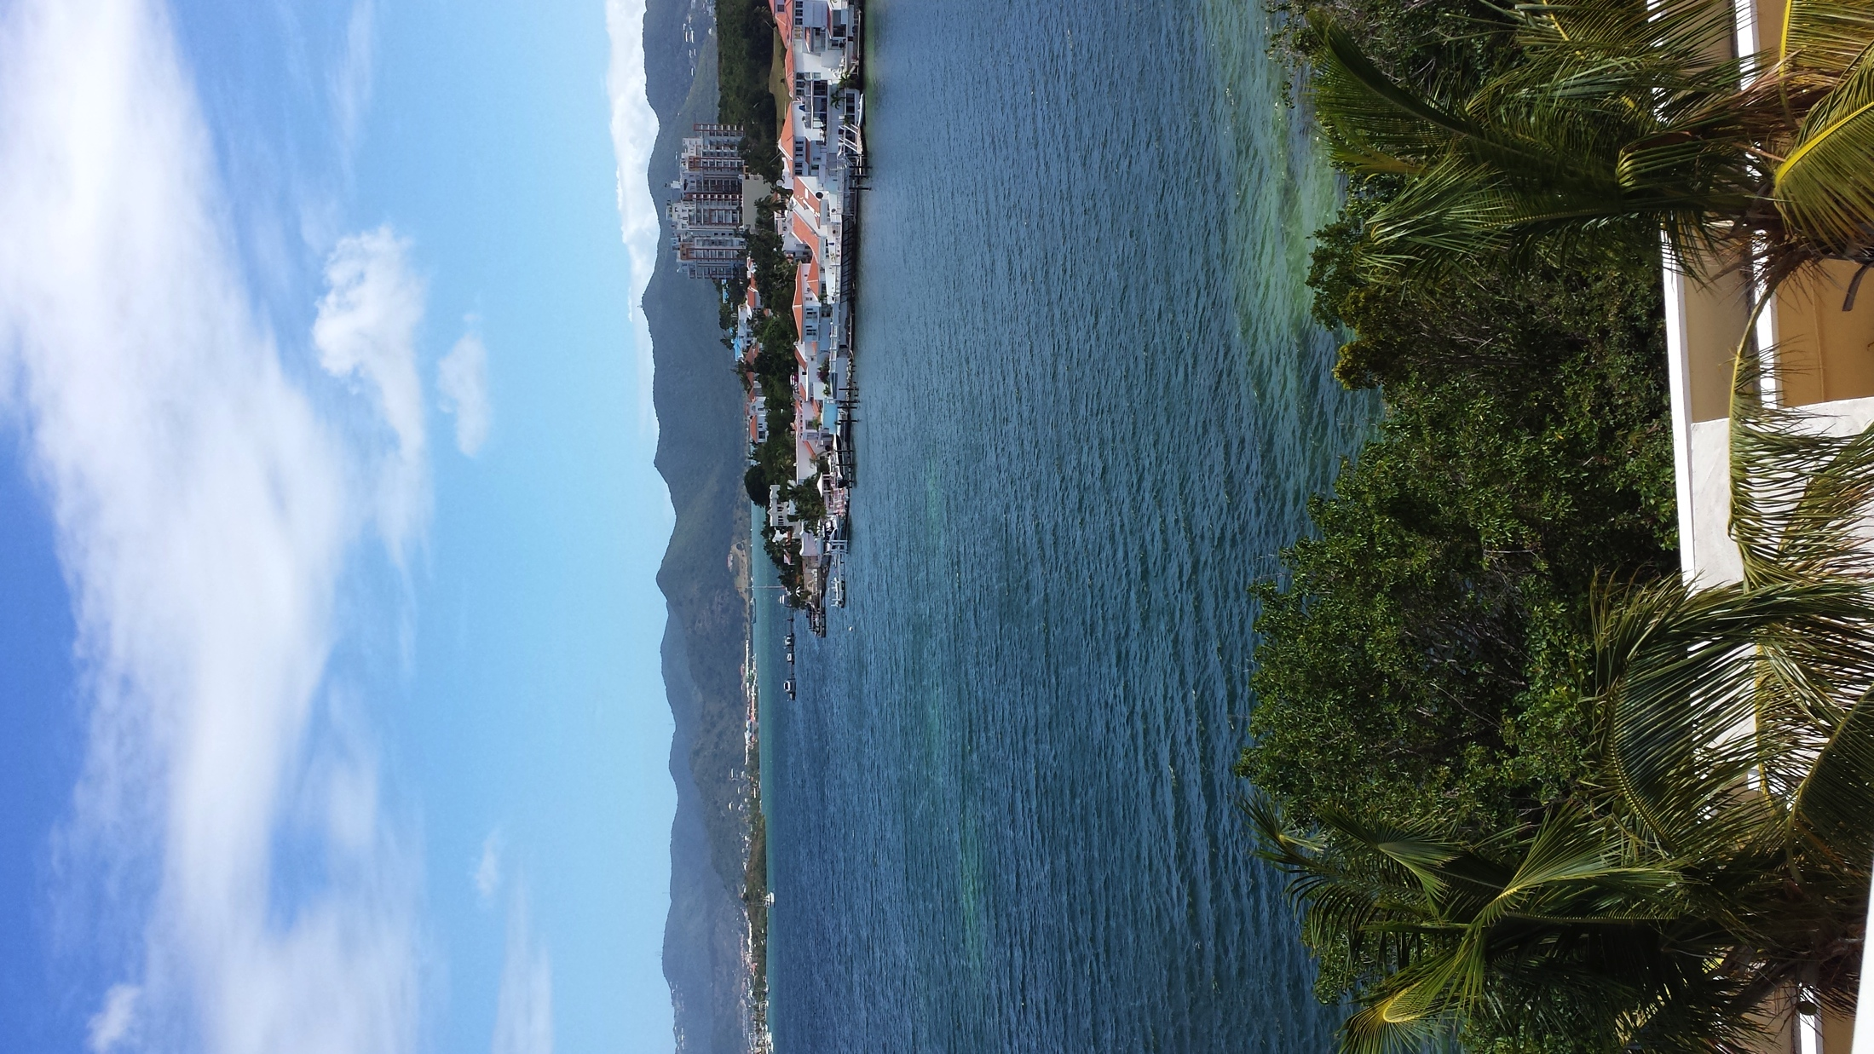
Look at the view!

Slide 19
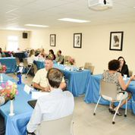
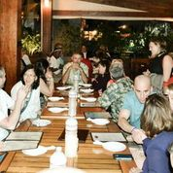
Take-Home Message
Groups of three advisors met with faculty members for about 10 minutes. They all love being able to focus on their teaching, instead of pressured to engage in research. Several still do research, but it is not their primary role there. There are also many “visiting” professors, who come for 8-weeks at a time. Students are randomly assigned to a faculty member for the whole time on island, unless they want to change. This is voluntary for faculty.

Slide 20
Student Feedback
Lunch break with current students, interacting with two former UCF students:
1st Semester Katherine Arn-2014
2nd Semester Meera Rathod-2014
One criticism was that professors for the same class keep changing, so no consistency. Other than that, they seemed o.k. with environment…but after all, the 1st semester student just arrived in January.
Another main negative, both from students and faculty, was the distance and cost to get back home.

Slide 21
AUC Alumni
Joseph Sadler, M.D.
Welim Azinge, M.D.
Benjamin Ho, M.D., a popular graduate of AUC and currently a Resident Physician at Medical Center of Central Georgia, wrote “The Diary of a Caribbean Medical Student” blog to help other students.
Notes:
Dr. Sadler said there was a stigma in his residency when they learned he was from AUC, but his performance wiped that out very soon.

Slide 22
Miscellaneous
Clinical rotations done in US and UK
Core Teaching Hospitals = 13 in NE, 7 in UK, and other miscellaneous sites
•Students receive help with residency applications
At the closing comments, each school advisor was given statistics on their own institution:
• 52 graduates of UCF have attended AUC
• Number of AUC alumni in FL (488)

Slide 23
Misc. (cont’d)
USMLE
2013-97% - first time pass rate (highest ever)
2014-93% - lower, but they claim it had to do with some components of the test changing
Residency can be anywhere within ALL 50 states
82.4 of AUC grads match
17.6 non-match (of these, 50% get placed within 2 years)

Slide 24
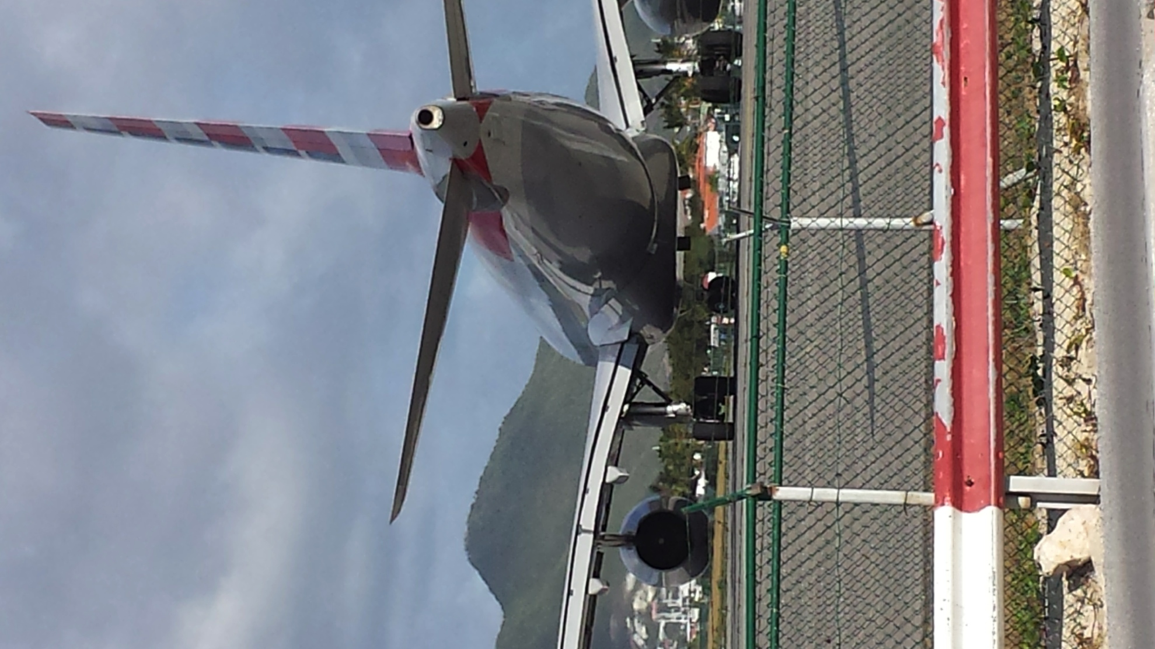
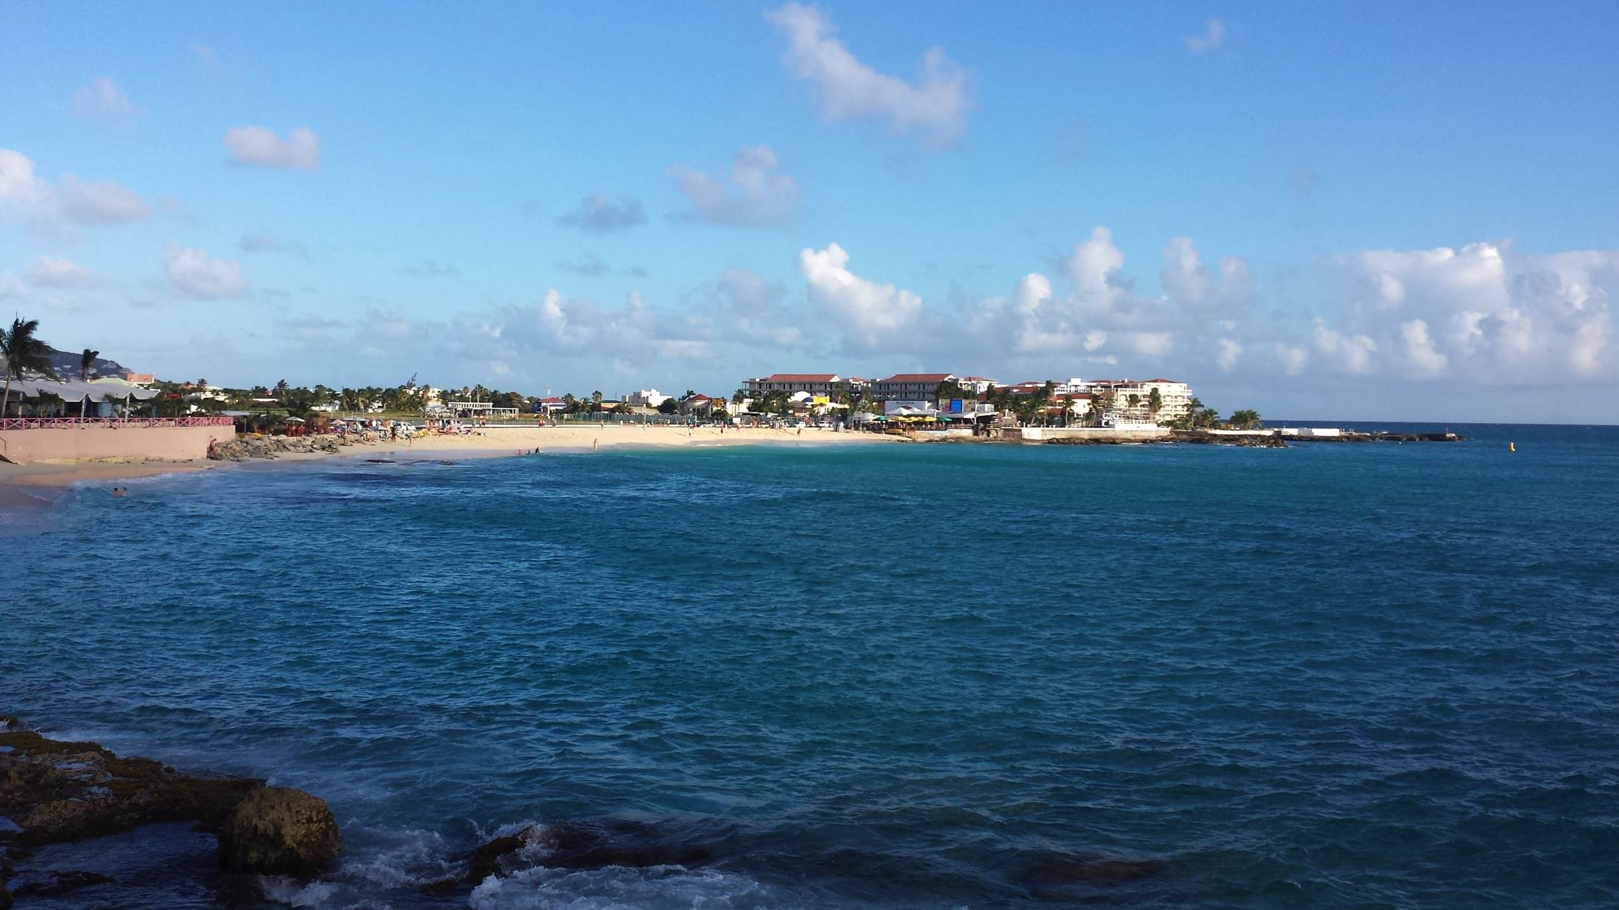
Philipsburg Airport
Maho Bay

Slide 25
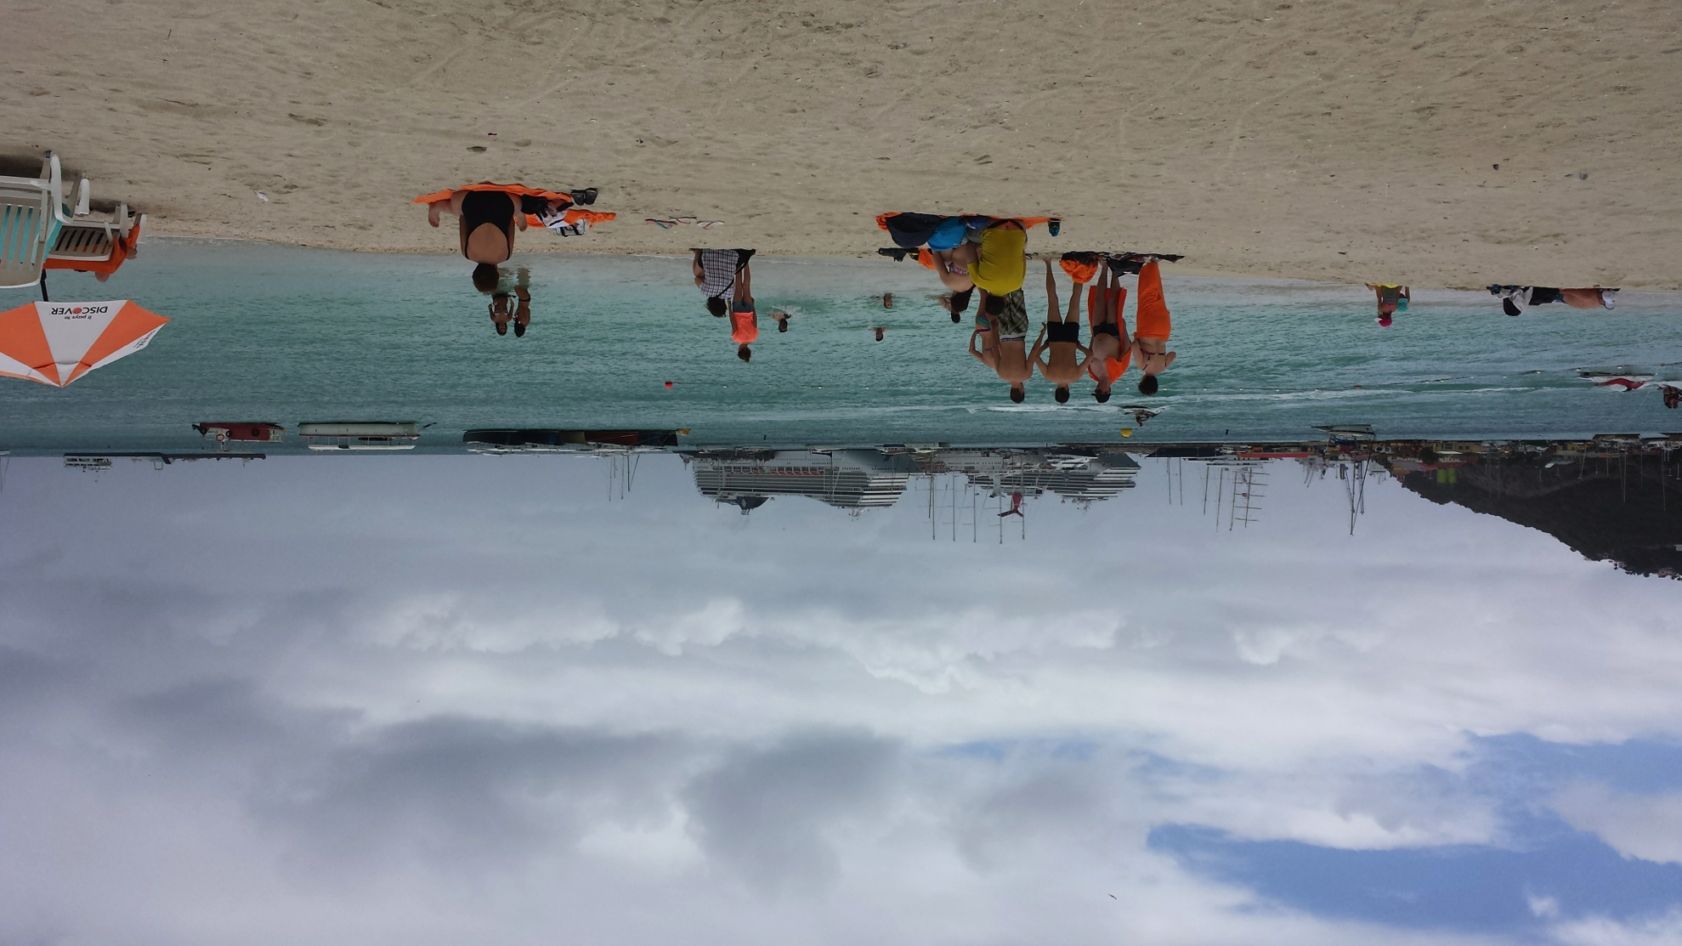
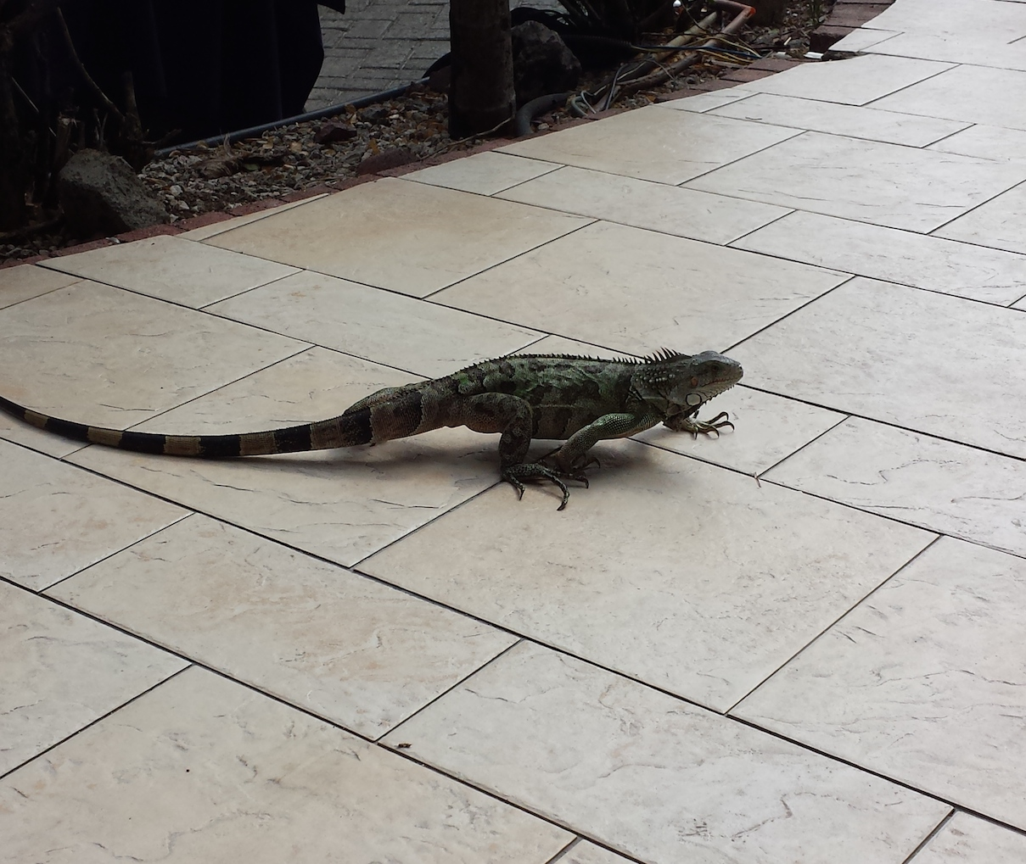
Island Facts
•St. Maarten is known as “paradise”
•AUC is on the Dutch side
•They thrive off of a tourist economy (began in 1980’s)
•37 square mile island
•110 nationalities on island

Slide 26
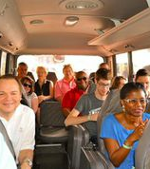
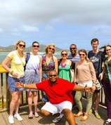
Tour of Island

Slide 27
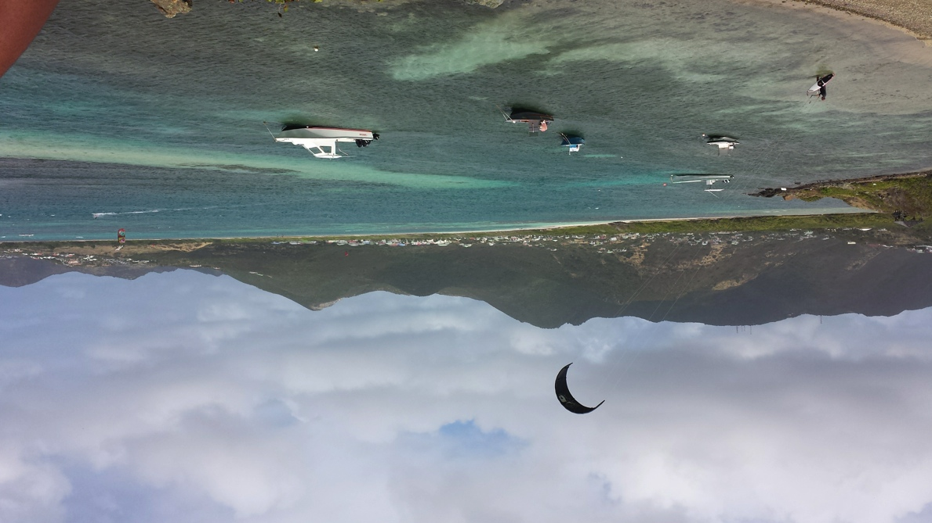
Various Points of Interest
Kite Surfing at Oyster Bay

Slide 28
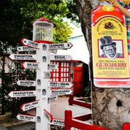
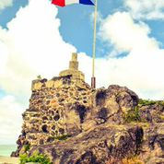
Philipsburg Fort Louis/Marigot
Notes:
Main town and capital of Dutch side-Philipsburg
Capital of French side-Marigot

Slide 29
The End
Thank you to AUC for hosting my trip!!

