Slide 1
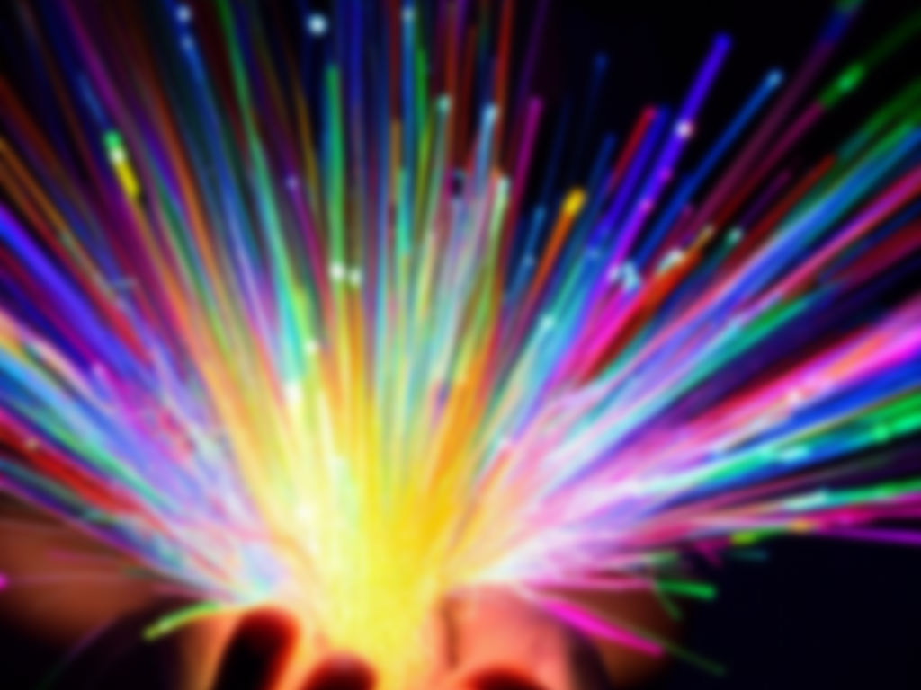
AS-STEM with PHOTONIC SCIENCE AND ENGINEERING SPECIALIZATION
Mike McKee
CREOL, The College of Optics and Photonics
UCF
mmckee@creol.ucf.edu
Radu Bunea
Valencia College
rbunea@valenciacollege.edu

Slide 2
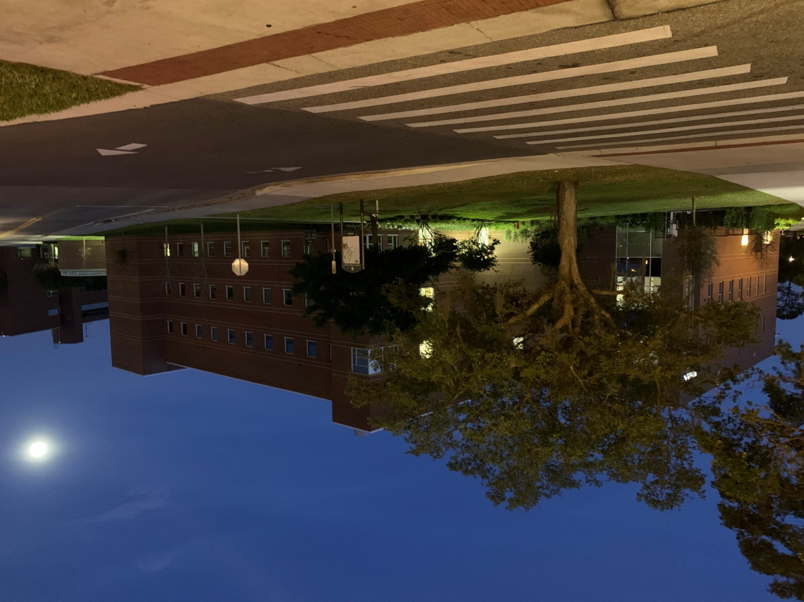
Photonic Science & Engineering
The BS Photonic Science and Engineering (BS-PSE) is a degree jointly offered by COP and the College of Engineering & Computer Science.
Only B.S. Program in Florida, one of only 6 accredited in the nation.
By the Numbers:
167 Students
150+ graduates
30% Female (highest among eng. majors)
51% Minority
$77K Average Starting Salary
Notes:
Norfolk State
Rose Hulman
Alabama Huntsville
Arizona
Rochester not yet
US

Slide 3
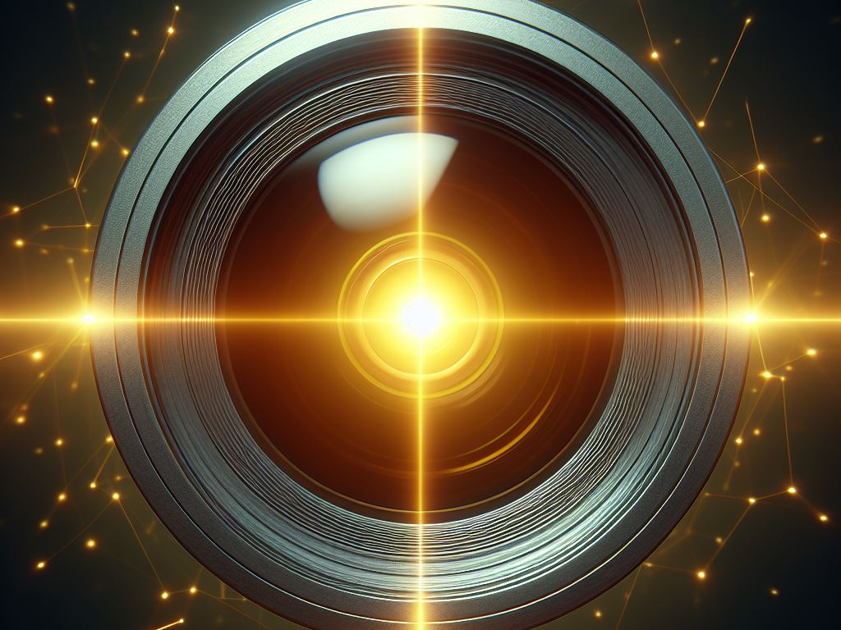
Current State – AS STEM Degree
No photonics related courses.
At 60 credits, AA is complete and often occurs prior to completion of math series.
Note: 37.5% of students arrive at UCF not capable of 3-Year Degree completion
Students can take the following:
Calculus | MAC 2311, MAC 2312, MAC 2313, MAP 2302
Physics | PHY 2048C, PHY 2049C
Chemistry | CHM 1045C
EGN 1006C | Intro To Engineering
EGN 1007C | Engineering Concepts and Methods
EGN 2440 | Prob. and Stats. for Engineers
EGS 2004C | Electrical Networks
EGN 2210C or COP 3275 | Engineering Analysis and Computation C/C++ Programming for Engineers
No photonics related courses.
64 Credits & AA is awarded but before math is complete
37.5% of students arrive at UCF w/o needed math level

Slide 4
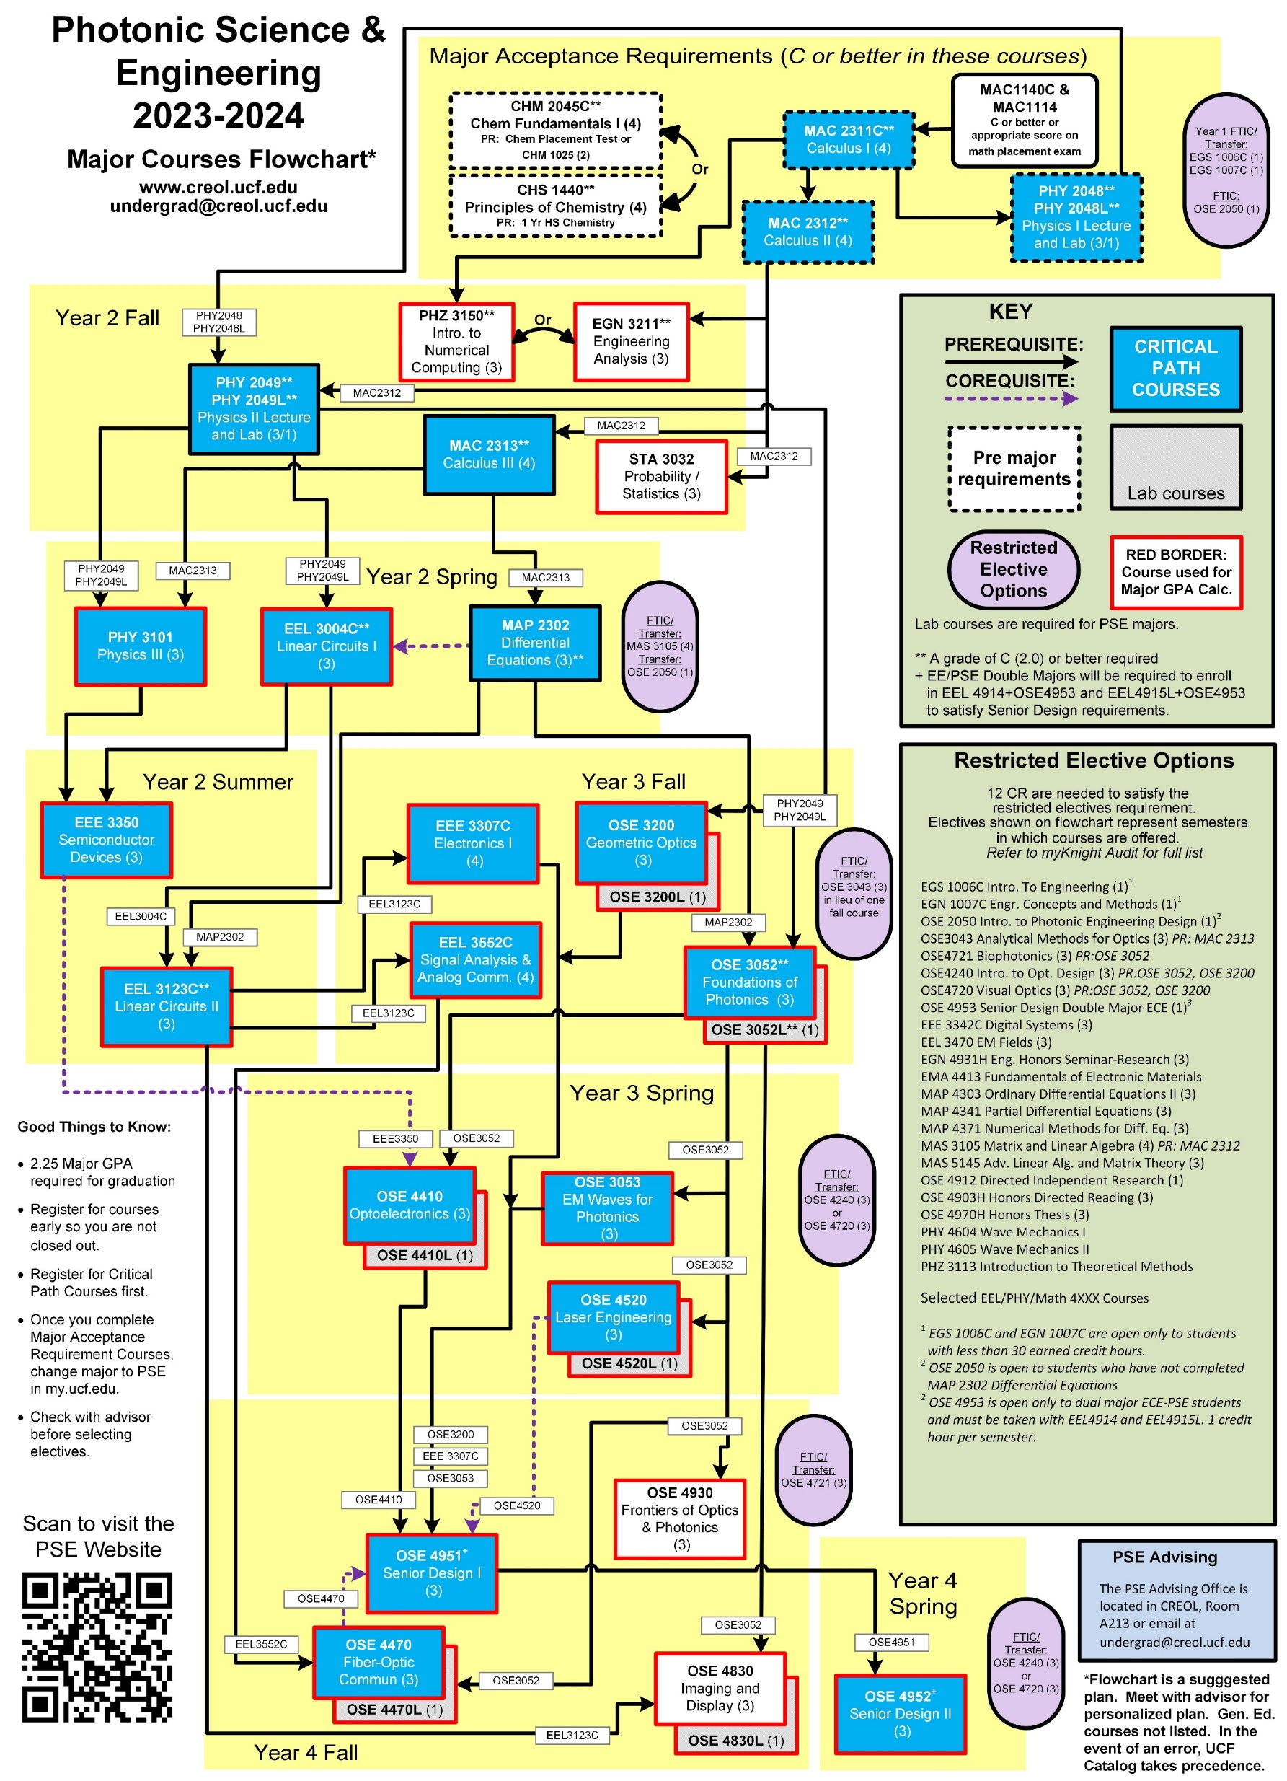
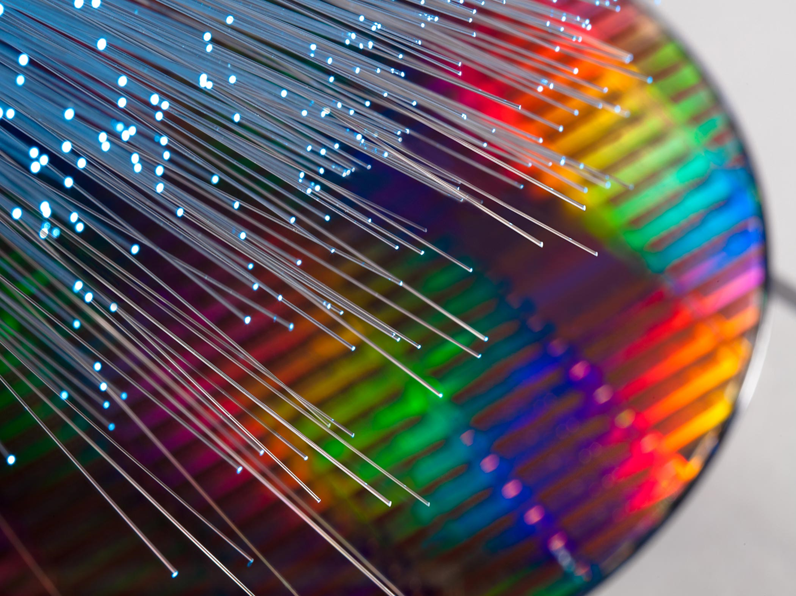
Photonic Science and Engineering Program:
Ideally, transfers from Valencia, still need 6 more semesters.
But this is not reality.

Slide 5
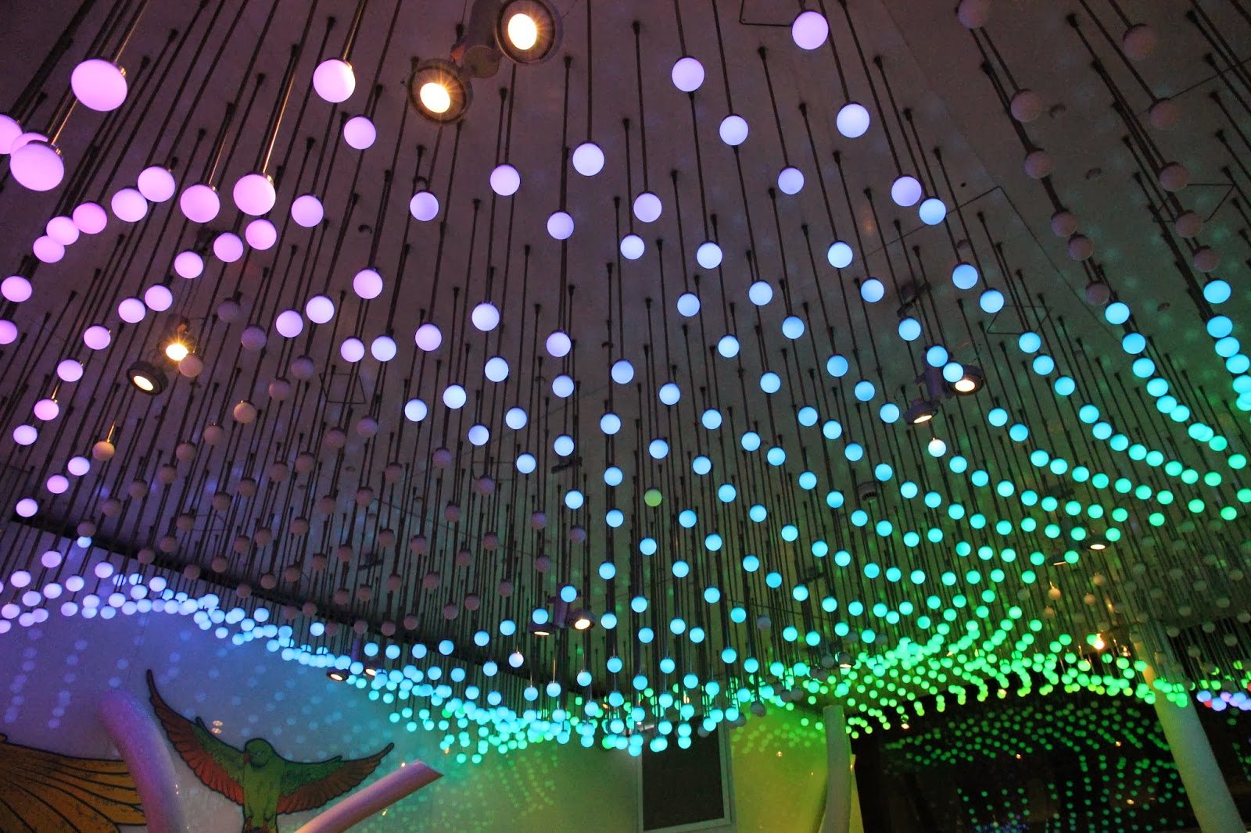
JOB Market
Estimated job market for photonics engineers:
U.S. – 10,400 job openings/year*
Florida - 700 job opening/year
U.S. graduates per year: 80-100
Median Salary in Photonics in the US is $135,000 per year.**
Economic impact of Florida photonics industry is $3.6 billion (>270 companies)
Photonics impact from private companies:
$3.085 TRILLION in revenue (vs. $29.7 trillion national total)
7.4 million employed (vs. 120 million employed)
*2023 www.onetonline.org
**2023 SPIE Optics and Photonics Global Salary Report

Slide 6
New Plan – AS-STEM
Add Classes at Valencia and adjust prerequisites at UCF
Valencia |  | UCF
ETS 1211C Introduction to Photonics Engineering Design | 1 | OSE 2050 Introduction to Photonics Engineering Design | 1
ETS 2210C Principles of Photonics | 3 | UCF 3000 Restricted Elective | 3
ETS 2215 Geometric Optics | 3 | OSE 3200 Geometric Optics | 3
ETS 2215L Geometric Optics Lab | 1 | OSE 3200L Geometric Optics | 1
ETS 2212 Foundations of Photonics | 3 | OSE 3052 Foundations of Photonics | 3
ETS 2212L Foundations of Photonics Lab | 1 | OSE 3052 Foundations of Photonics Lab | 1
Photonics Courses offered early
64 Credits allowed
Students will arrive math and program ready

Slide 7
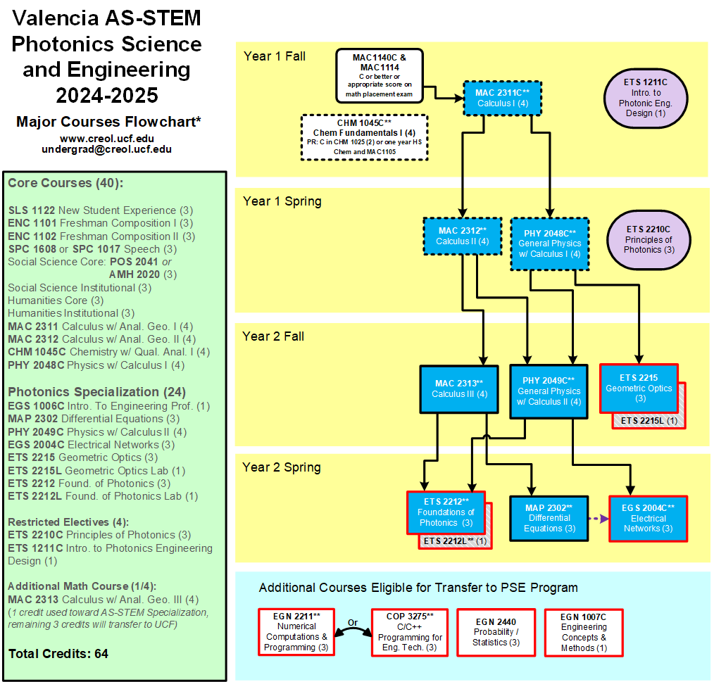

Slide 8
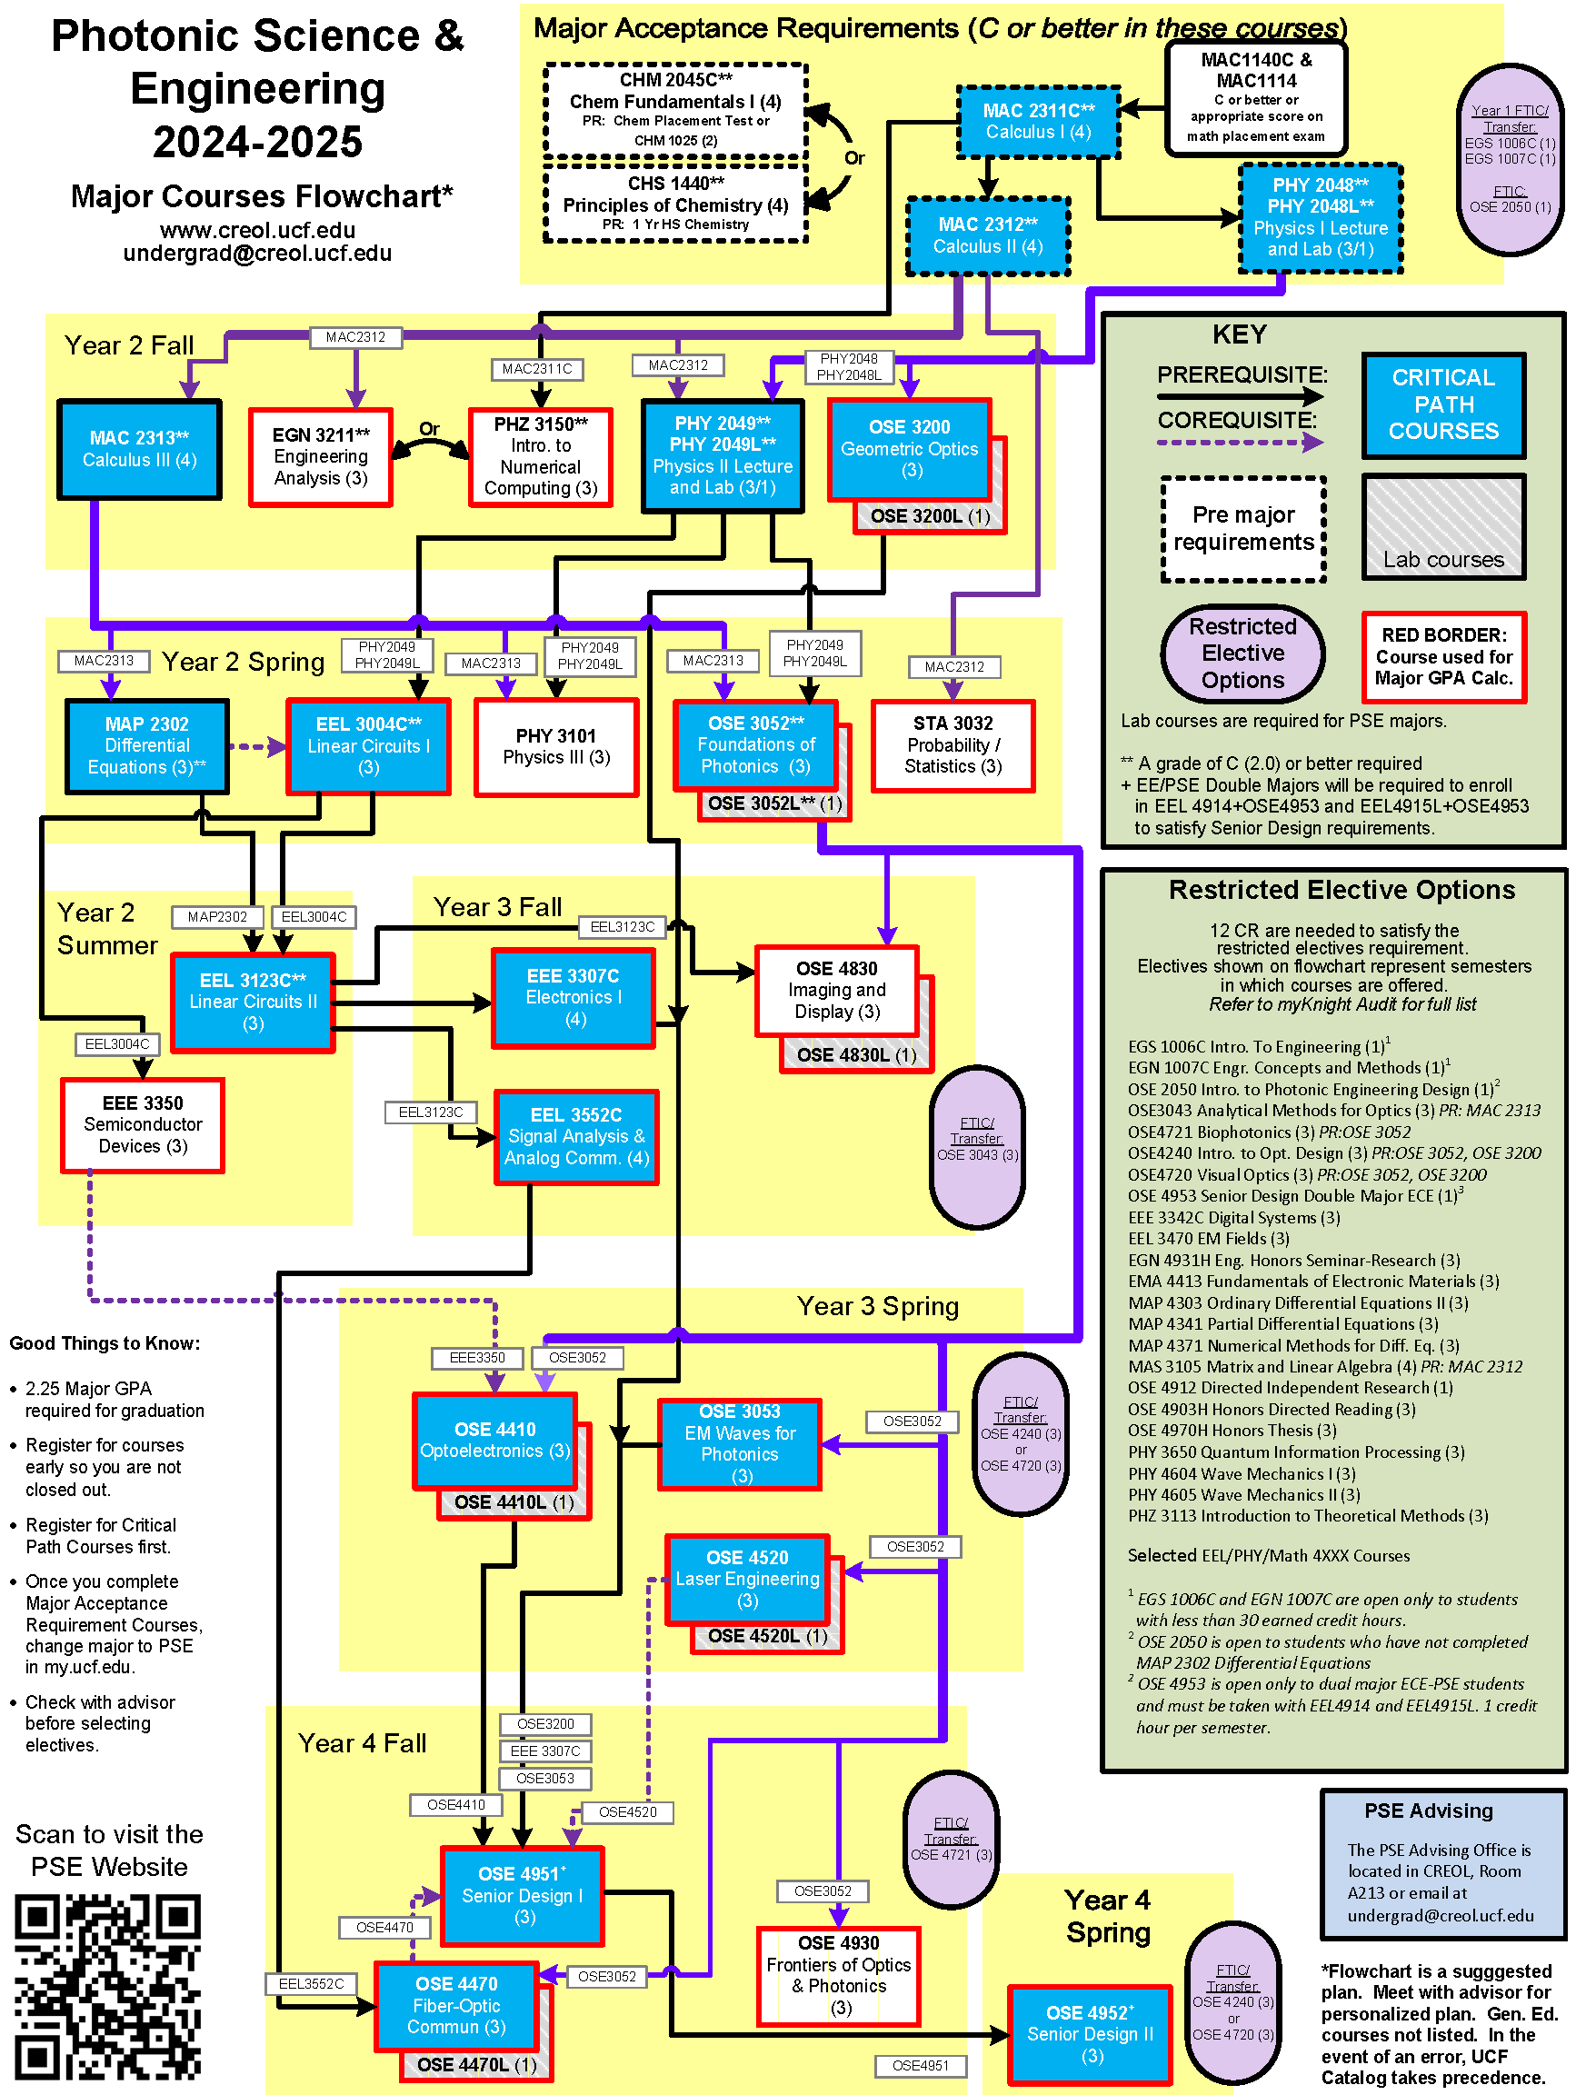
Graduation Requirements
128 Credit Hours
9 hours of summer credit
2.25 Major GPA
2.00 UCF GPA
Plus additional requirements
If you are interested in Photonics, take OSE 2050 next semester!

Slide 9
Effect of Changes
Promotes Photonics to a wider group of students
Allows for transfers to complete PSE degree in 3 years.
Allows students to start photonics courses early.
AS-STEM allows for more than 60 credits.
Students will need to declare AA and AS-STEM degrees.
Then, students are awarded AA degree to satisfy Direct Connect/GEP.

